Slide 1
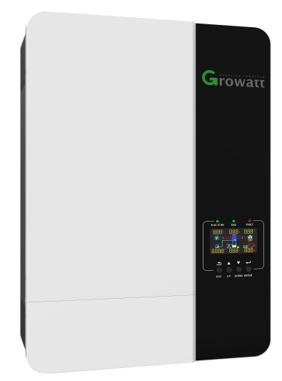
Off-Grid Inverters
SPF 5000 ES Series

Slide 2
Content
CONTENTS
1
3
www.ginverter.com
Higher Yield
Safe & Reliable
2
4
Application
Smart & Capable

Slide 3
1
Higher Yield

Slide 4
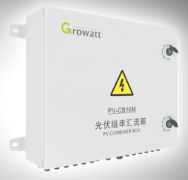
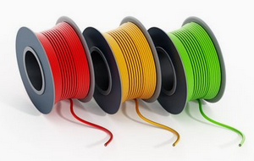
Investment
Investment of Off-Gird System
ES Series Inverter:
PV input directly connect to PV terminal (no need install combiner box)
Without battery operating mode (save the investment of battery)
Solar panels in a string and without battery (Save the cost of PV and battery wiring)
(Inverter, solar panel, combiner box, battery, wire, installation)
Inverter
Installation
Wire
Battery
Combiner box
SPF 5000 ES

Slide 5
Power Factor
5KVA=5KW
5KVA=4KW
Output power factor : 1.0 (5KVA=5KW)
Power factor : 1.0
Power factor : 0.8
Inverter 100% load, still work normally
Over-load 125%, inverter stop working
5KW Power Appliances

Slide 6
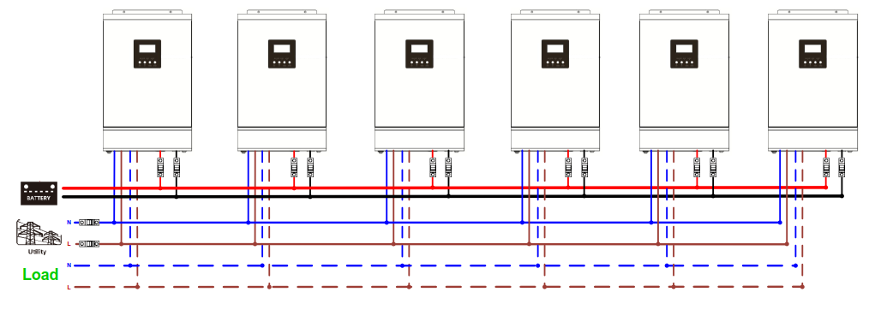
Parallel Operation
Parallel operation with up to 6 units only for 4/5KVA, the maximum system output up to 30KW, and also can be set to a three-phase system
Three-phase system
Single-phase system

Slide 7
Smart & Capable
2

Slide 8
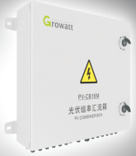
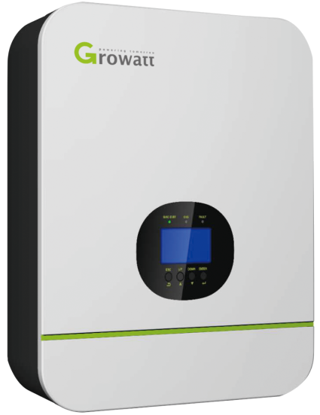
Flexibility
General inverter application Max. PV Input is 145VDC
SPF 5000 ES
Combiner box
1- SE series inverter input range up to 450VDC without
combiner box for PV input.
2- Convenient for installation and save the cost of wiring
and combiner box.
SPF 3000-5000TL HVM

Slide 9
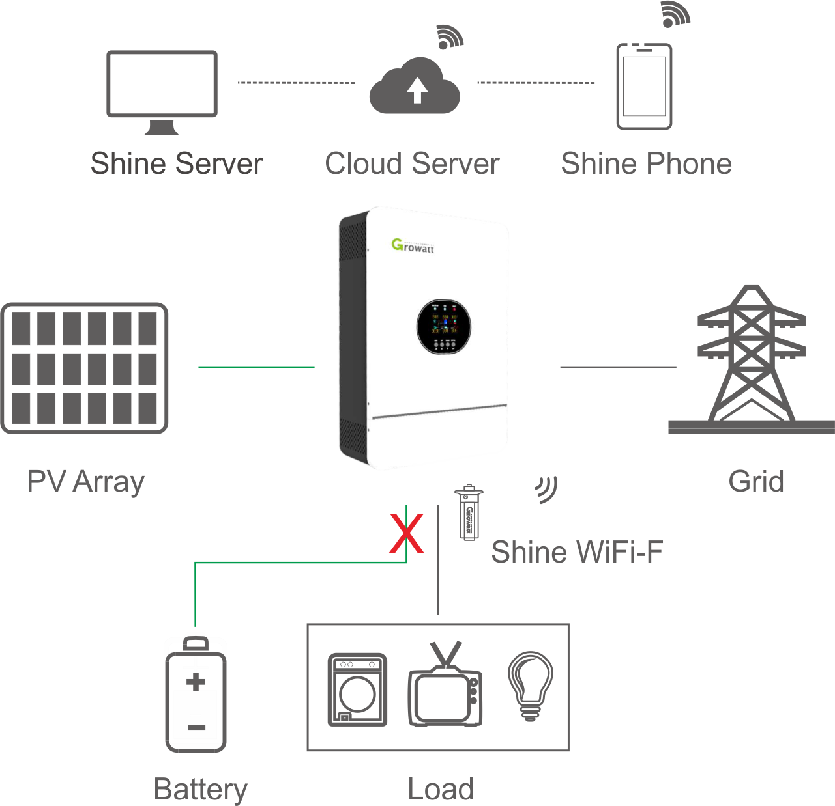
Without Battery Mode
Directly connect solar panel and utility power without battery operation mode
Connect battery for energy storage and back-up support

Slide 10
Safe & Reliable
3

Slide 11
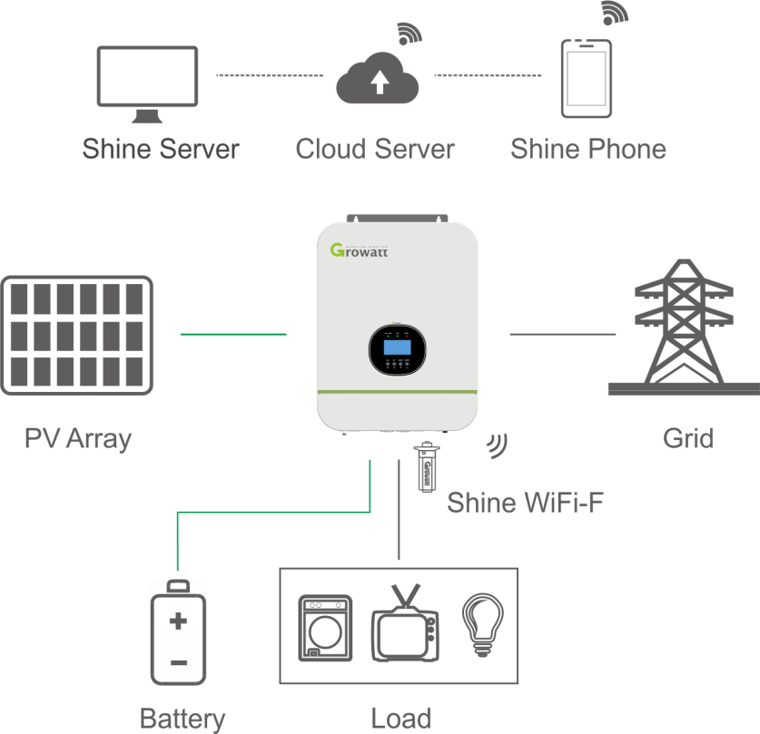
SUB Mode
If solar is sufficient ,solar supply power to load, utility will supply power to load at the same time when solar power is not sufficient .

Slide 12
Battery Discharge Setting
Setting voltage point back to utility or battery mode:
Back to utility mode voltage range: 44-51.2VDC
Utility charging
Battery discharge

Slide 13
Utility Charging Setting
Setting voltage point back to utility or battery mode:
Back to battery mode voltage range:48-58VDC
Battery discharging
Utility charging

Slide 14
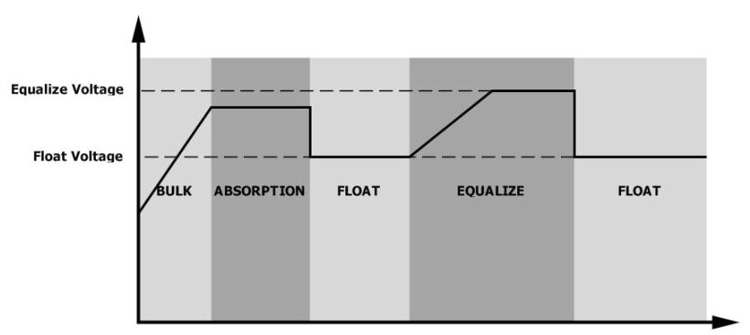
Battery Equalization
Inverter can setting lead-acid battery equalization charge interval time and charge voltage to active lead-acid battery feature then further can extend lead-acid battery life.
Charging curve

Slide 15
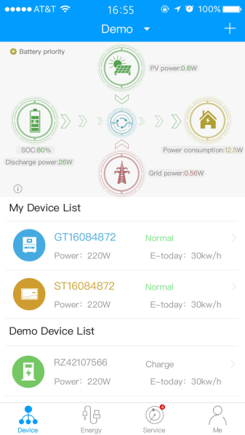
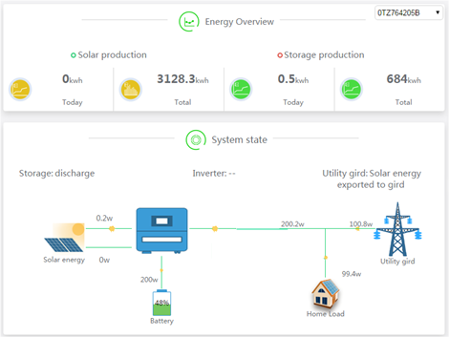
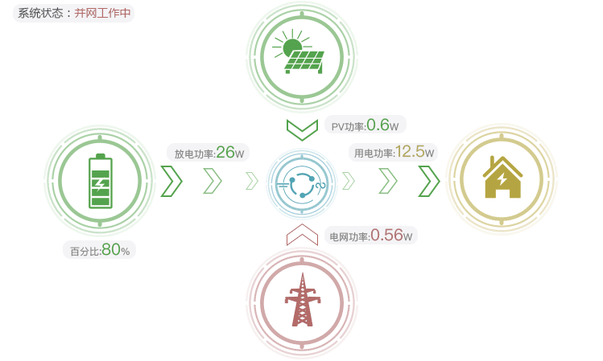
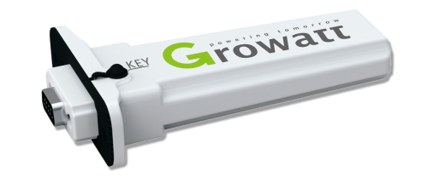
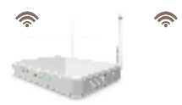
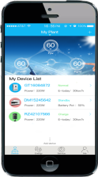
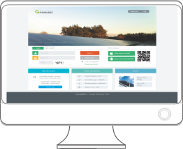
HMI Operation
Remote monitoring
WIFI, GPRS communication port for remote
monitoring (Supported for 4/5KW)
WIFI-F
GPRS-F
ShinePhone APP
ShineServer

Slide 16
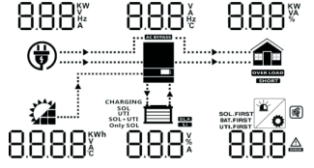
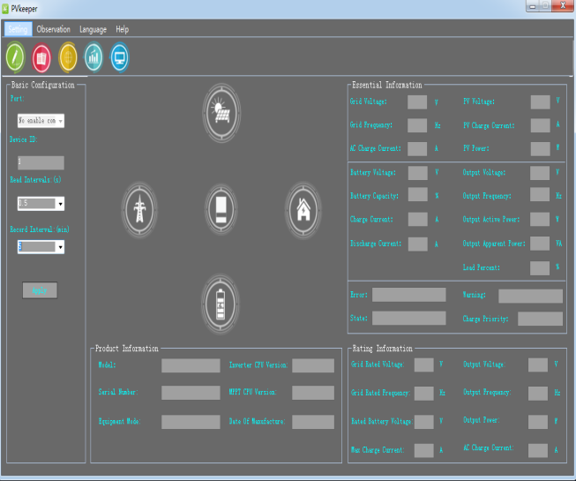
HMI Operation
Display screen (Color Display)
SPF 5000 SE
PVkeeper monitoring platform
USB cable
1. Input information (PV voltage, AC voltage, frequency, PV generation, battery voltage, charger current)
2. Output information (voltage, load percentage, frequency, load in VA, load in watt, discharging current)
PC install monitoring software

Slide 17
Application
4

Slide 18
Enhance Battery Life
Solar power is sufficient (Feed to load and also charge the battery). When solar power is not available, Utility supply power to the load and charge the battery
Solar power is sufficient
Solar power is not available
Priority mode : Solar first

Slide 19
Save Electricity Bills
When Solar power is sufficient (it feeds to load and charge the battery). For cost-effective support, Utility feeds power only if the battery feeding is under low-level warning
.
Solar power is sufficient
Solar power is not sufficient
Priority mode : SBU first

Slide 20
Off-Peak Charging
The time of grid power support and battery discharge can be set during off-peak or peak time
Peak time
Off-Peak time

